Slide 1


UNIVERSITY
KARNATAK
DHARWAD
Janata Shikshana Samiti’s
JSS Shri Manjunatheshwara Institute of UG & PG Studies Vidyagiri, Dharwad-580004.
A INTERNSHIP REPORT
“ULTIMEZ TECHNOLOGY”
INTERNSHIP PERIOD: 10 APRIL TO 10 JUNE
BACHELOR OF COMPUTER APPLICATION (BCA)
Submitted By
ROHIT BALLARI
BCA VI SEMESTER
UUCMS: U02BF21S0204
DEPARTMENT OF COMPUTER SCIENCE
2023-2024

Slide 2

Company overview
Ultimez Technology Pvt Ltd.
Ultimez Technology Pvt Ltd is a professional web design and development company based in Hubli, Karnataka, India. It offers Web Services, Software Solutions, and Digital Branding.

Slide 3

Company Services
Web and Mobile App Design
Web and Mobile App Development
Online Marketing
Others
Server Management
Integration
Web Hosting Services
Domain Name Registration

Slide 4

INTERN ROLE AS WEB DEVELOPER
As a Junior Web Developer intern at Ultimez Technology, I will be responsible for assisting in the development and maintenance of the company's Learning Management System. My role will involve working closely with senior developers, designers, and other team members to create user-friendly, responsive, and efficient web applications.

Slide 5
Languages And Tools
I have utilize a diverse set of languages and tools to work on various aspects of the projects in ultimaze. The languages and tools they are likely to use:
HTML: HTML Used for structuring the content of web pages, creating the foundation for web development projects.
CSS :CSS will be used for styling and formatting the visual presentation of web pages, ensuring a polished and professional look.
Bootstrap: Bootstrap makes responsive web design a reality. It makes it possible for a web page or app to detect the visitor's screen size and orientation and automatically adapt the display accordingly.

Slide 6
JavaScript :JavaScript is used for adding interactivity and dynamic functionality to web pages,making them more engaging and responsive.
PHP : (HyperText PreProcessor) PHP is A Server Side Scripting Language Designed Specifically for Web Development.
MySQL:It Is A Relational Database Management System
Vercel:It is the Frontend Cloud. Which is used to host the website.

Slide 7

About The Project
Project Name:car rental management system
INTRODUCTION
The project is a Car Rental Management System website which, If any user/Customer wants to Take Rent The Car then he can book the Car as per his Requirement.we have designed this website very well which is very good in appearance and working.
Languages we used for our project:
HTML
CSS
JAVSCRIPT
BOOTSTRAP
PHP
MYSQL

Slide 8

Objectives
• To produce a web-based system that allow customer to register and reserve car online and for the company to effectively manage their car rental business.
• To ease customer’s task whenever they need to rent a car.
• As all the system is computerized, there is no need to fill any application form for renting purpose. So, the paperwork will be very less.
• To make sure a user gets his desire car as early as possible. The car rental system will provide a faster response to complete the process

Slide 9
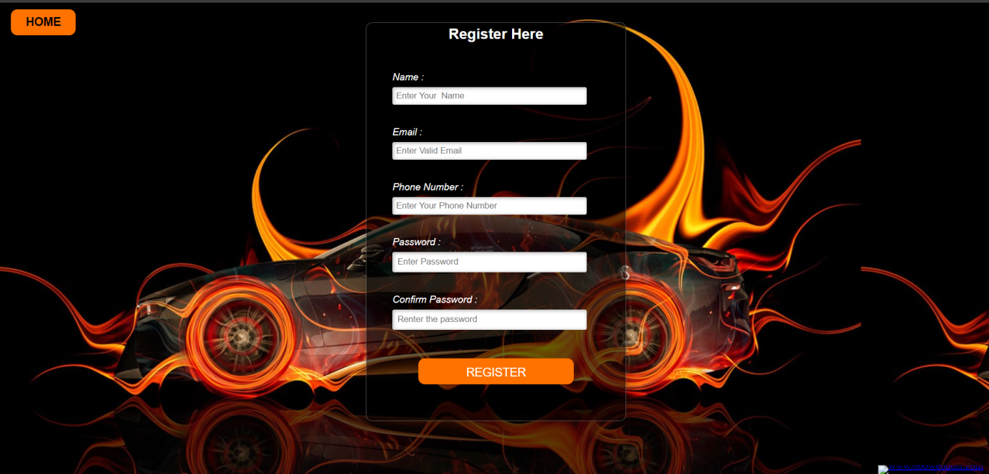
Register Module
The user needs to provide their first name, email, phone number, password, confirm password for registration.
These details will be stored in database.

Slide 10
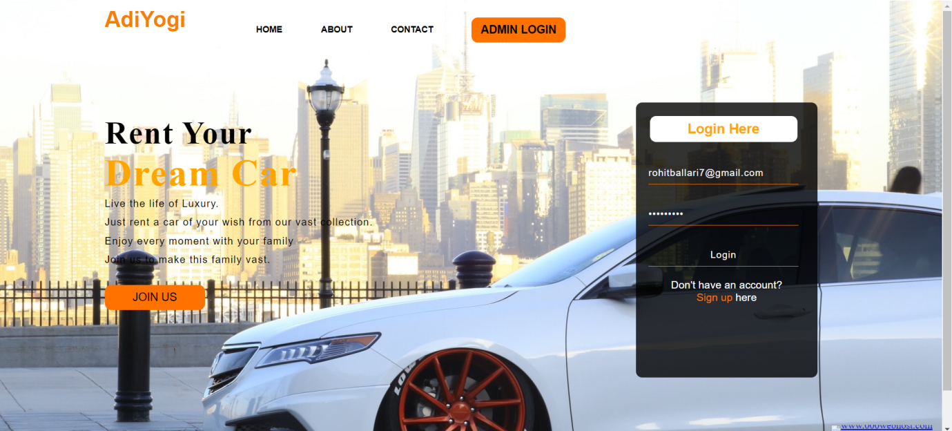
Login Module
For login user will input their email and password .
Admin will provide their admin id and password which will compared with a database content.

Slide 11
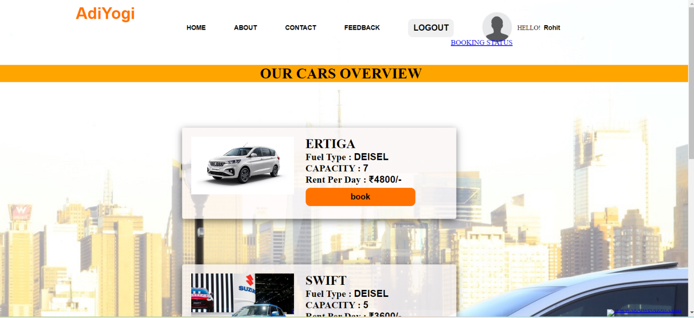
Cars Overview Module
User can view the list of cars
It asks the user to choose the car it contains the details like fuel type, capacity, rent per day.
User can select their preferred car and book for the same.

Slide 12
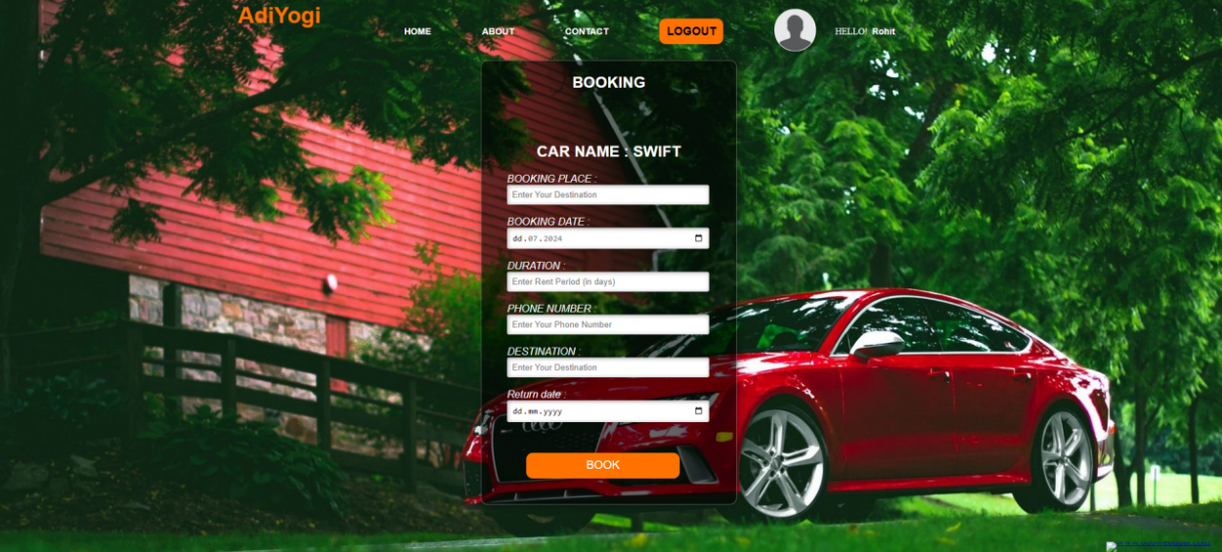
Booking Module
The booking details of cars are provided by the admin.
It asks the user to enter booking place, booking date, duration, phone number, destination, return date.

Slide 13
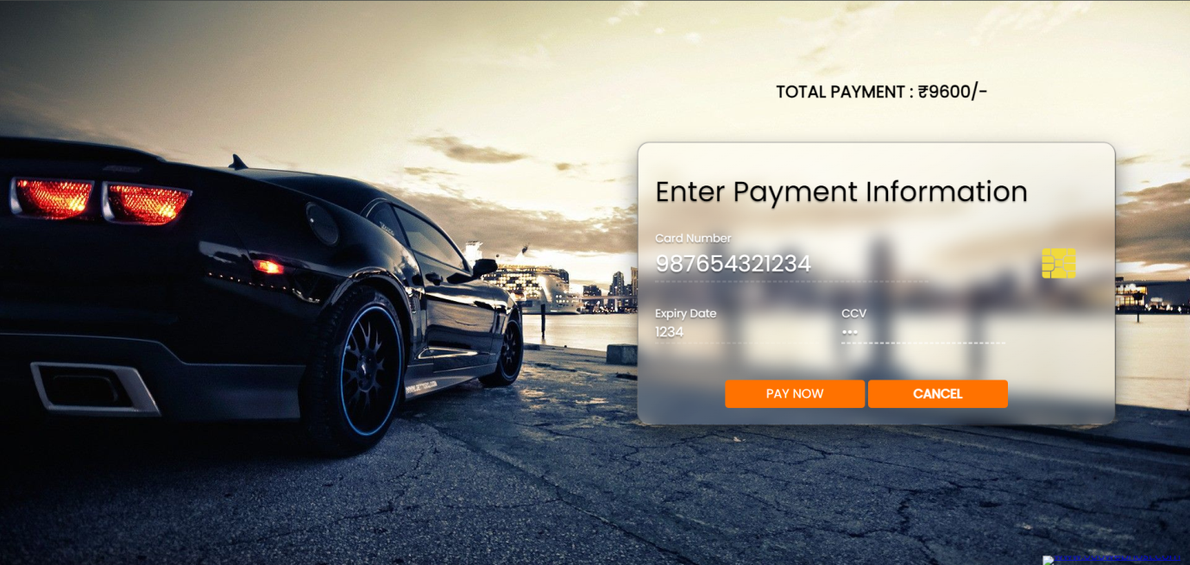
Payment Module
User should able to make payment by filling card number, expiry date and CVV are provided by the admin.
After payment user will get the payment successful popup window

Slide 14
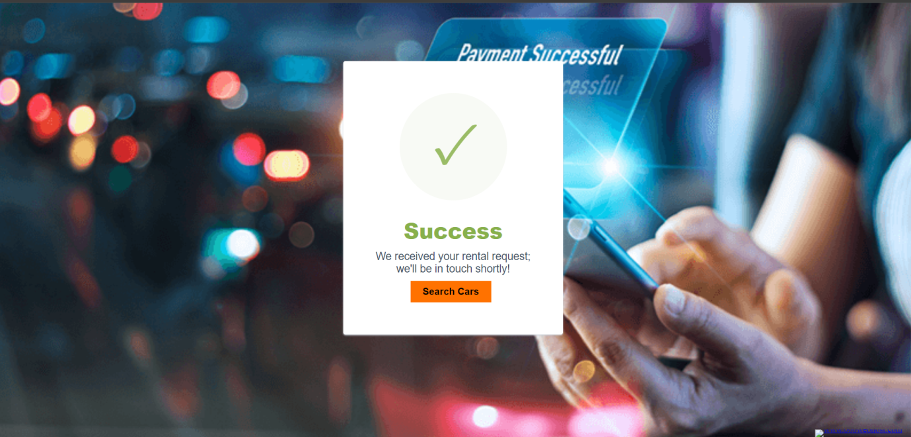

Slide 15
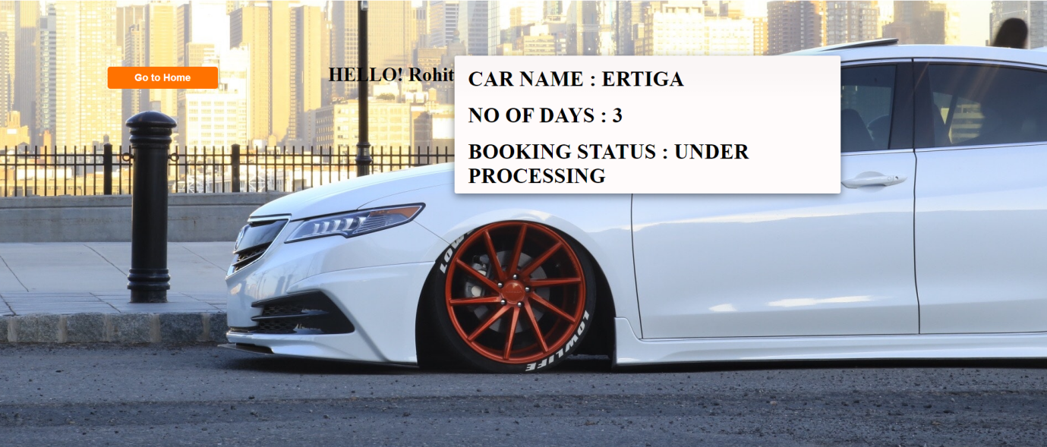
Booking Status Module
It indicates bookig status page.It shows user booking details.

Slide 16
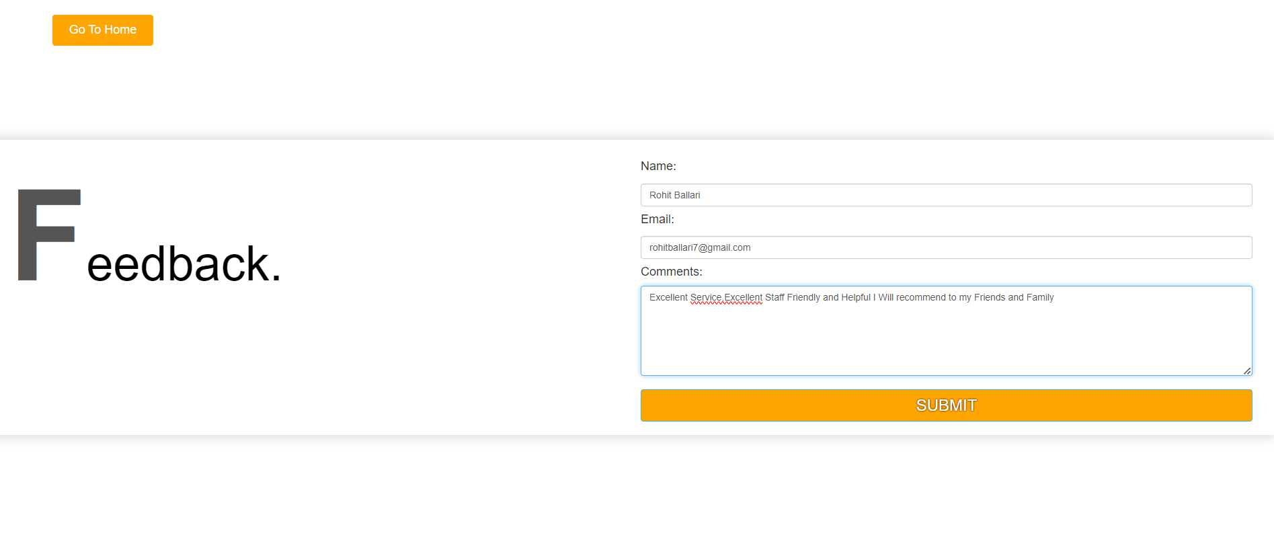
Feedback Module
It indicates Feed back page. It asks the user enter details like name, email, comments where registered user can give their valuable feed of their experience .
.

Slide 17
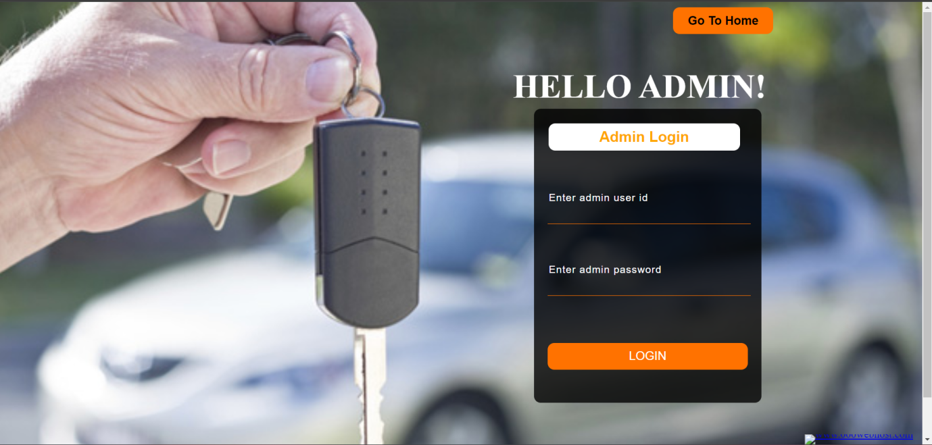
Admin Login Module
It indicates admin login page. It asks the admin to enter details like admin_id and password.
.

Slide 18
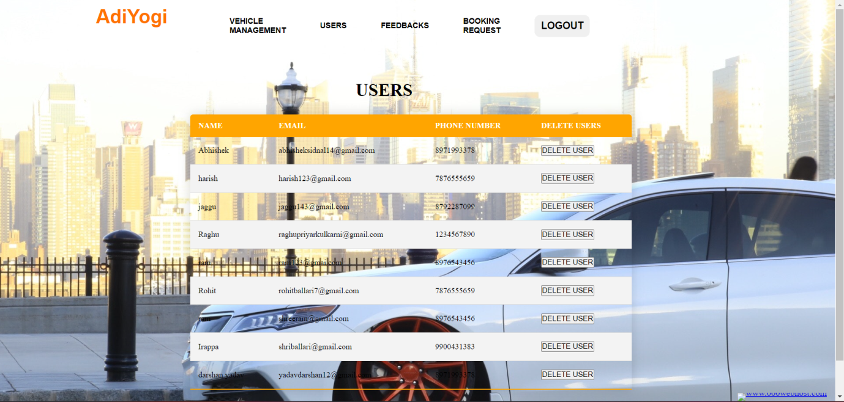
User Module
It indicates User page. It includes details like name, email, phone number, delete user where admin can delete the user details.

Slide 19
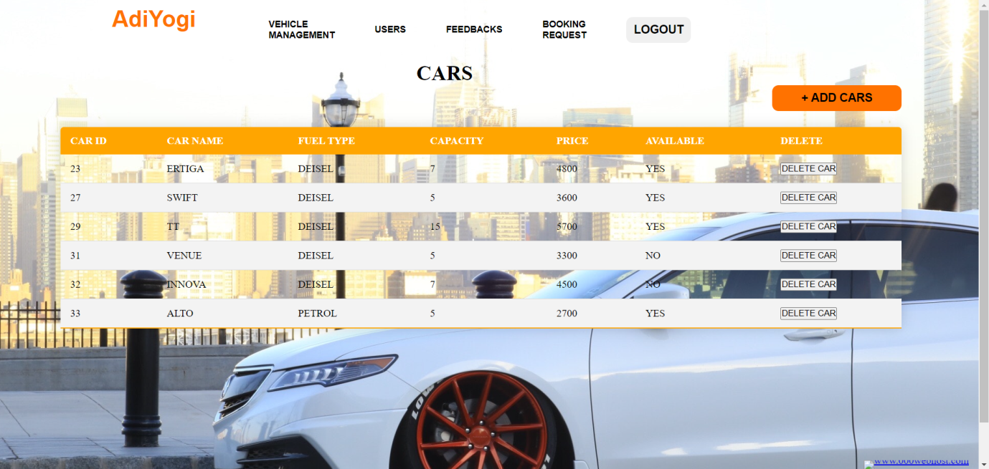
Vehicle Management Module
It indicates vehicle management page. It contains the details like car id, car name, fuel type, capacity, price, available, delete where admin can see the car availability status and delete the car details.

Slide 20
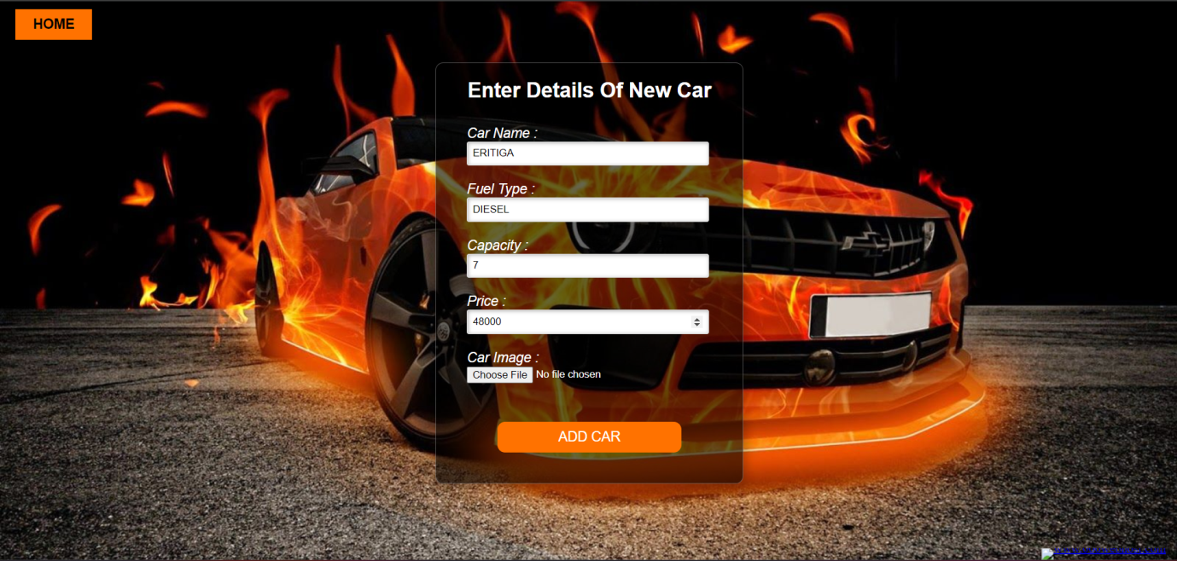
Add Car Module
It indicates add car page. It includes details like car name, fuel type, capacity, price, car image where admin can add the new car details by specifying it’s details.

Slide 21
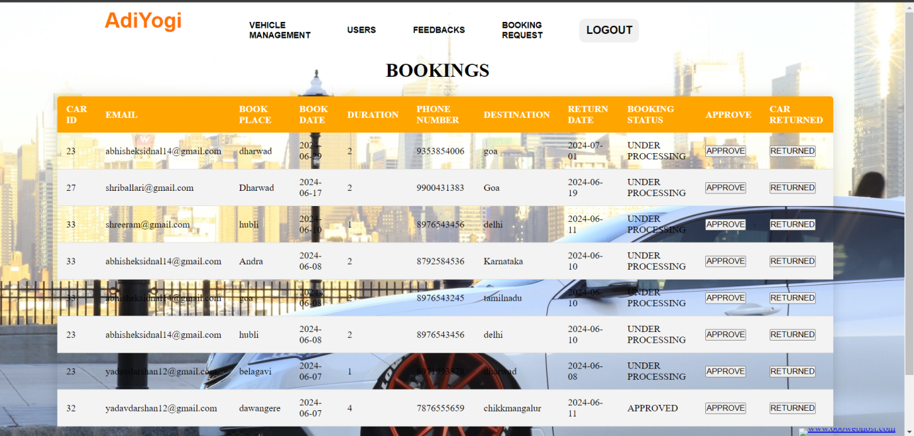
Booking Module
It indicates booking page. It includes the details like car id, email, book place, book date, phone number, destination, return date, booking status, approve, car returned where admin can give approve to the bookings done by the user and can also check the returned status of the car.

